Slide 1
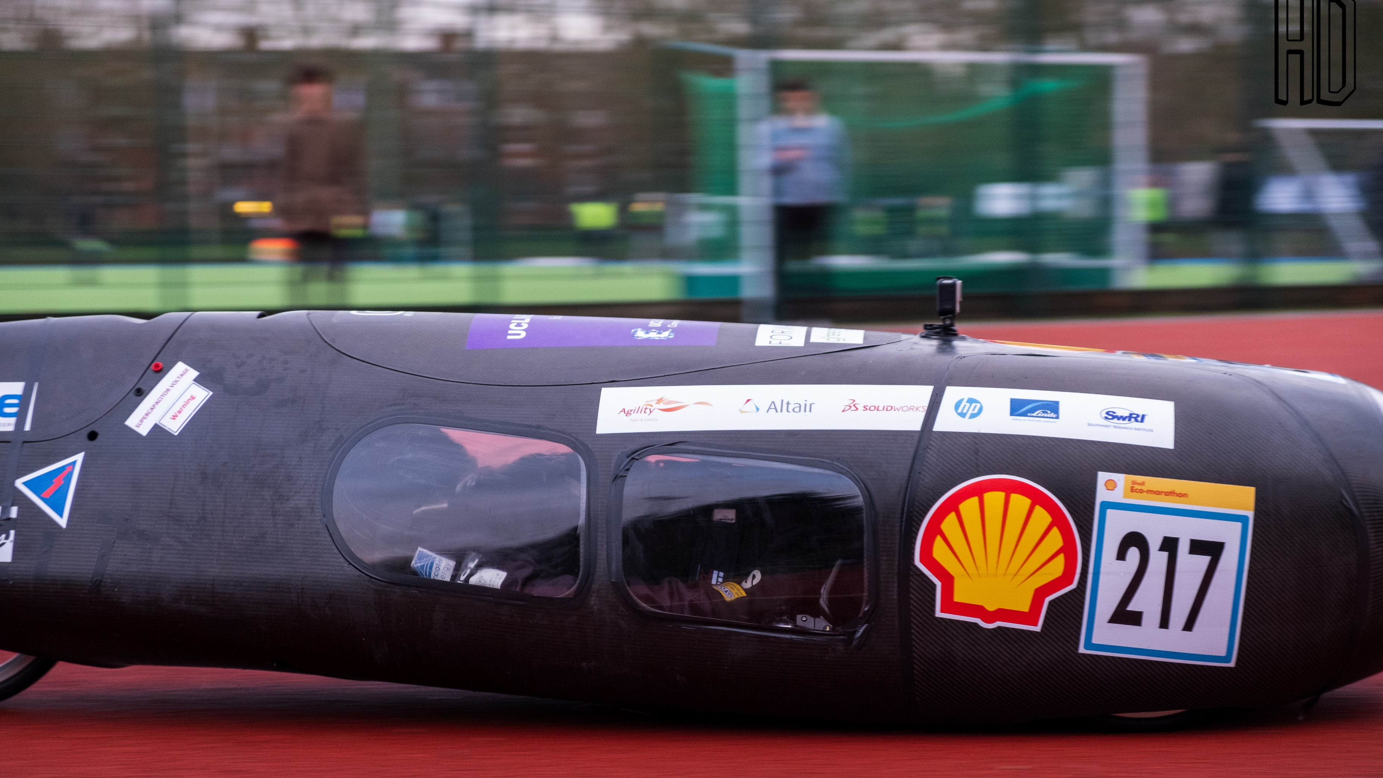
Designing a lap time simulator for the Shell Eco-Marathon
Hasha Dar

Slide 2

Physical Testing
Project Aims
Scope
Time
Cost
Process track and vehicle parameters
Simulate vehicle performance around a track
Output performance data

Slide 3
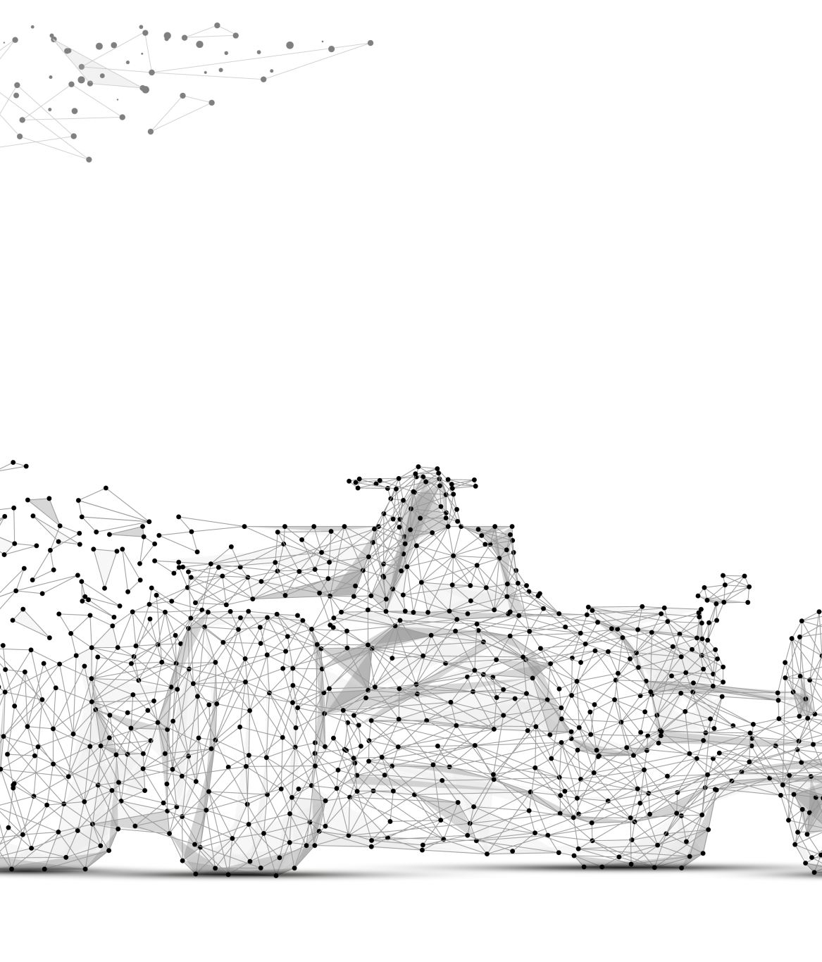
Project Aims
Process track and vehicle parameters
Simulate vehicle performance around a track
Output performance data

Slide 4
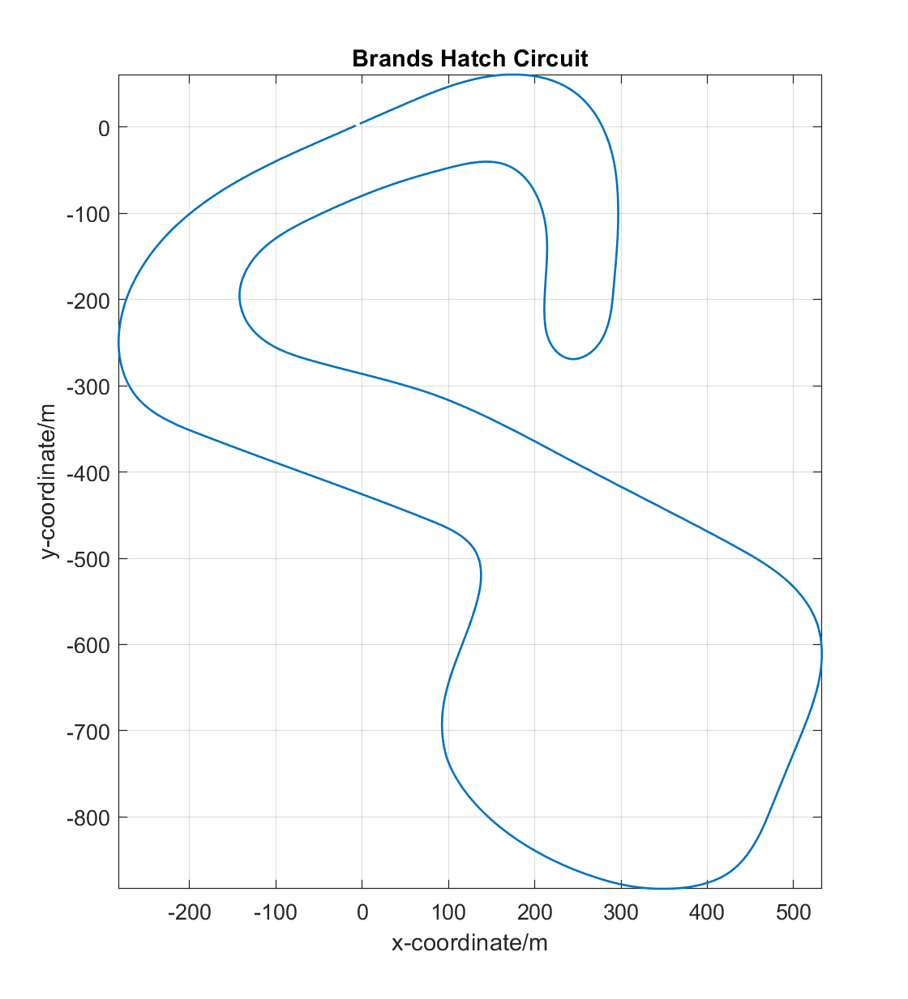
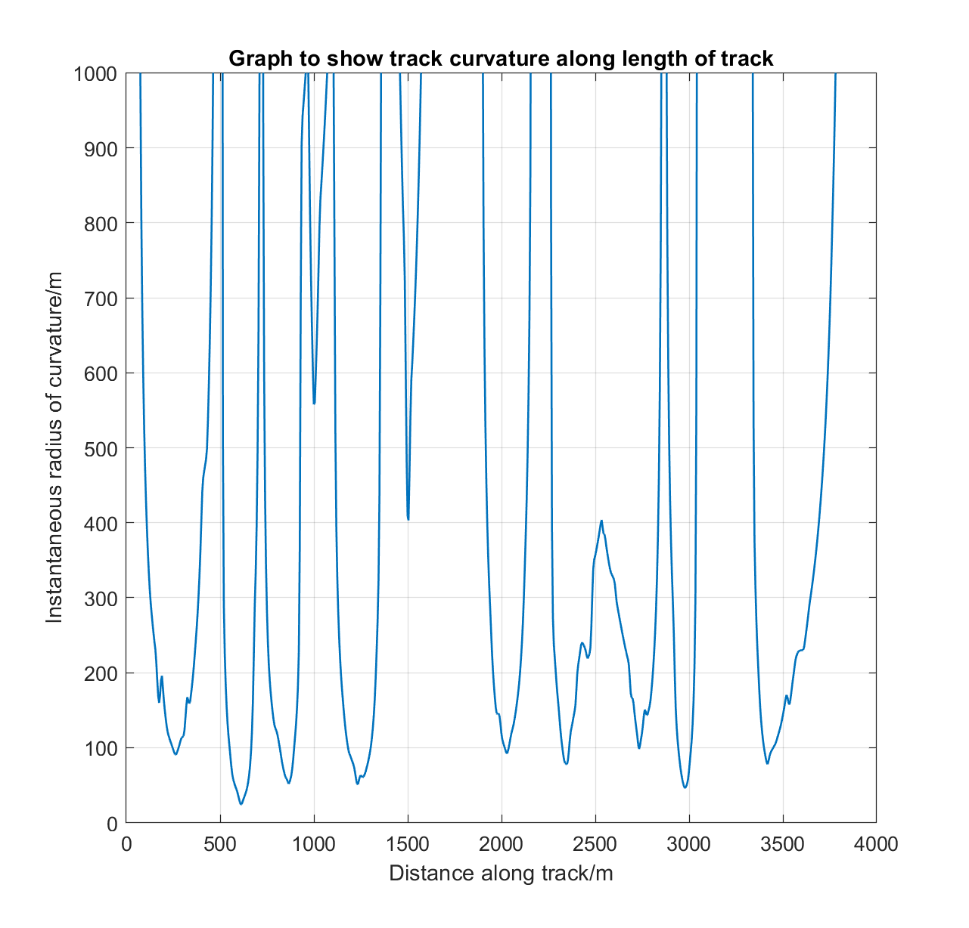
Track data
‘xyz’ coordinate data
Track curvature
Slope analysis

Slide 5
Simulink processing
Motor model
Transmission model
Vehicle model
Output processing
Tyre model

Slide 6
Motor and transmission models
Simscape mechanical toolbox
Motor characteristics modelled
Input: throttle position (0-5V)
Output: motor torque output (Nm)
Drivetrain efficiency
Gear ratio
Input: motor torque (Nm)
Output: wheel torque (Nm)

Slide 7
Vehicle model
Friction limit, aerodynamic forces, rolling resistance, slope force
Force balance
Inputs: Wheel torque (Nm), tire forces (N)
Outputs: Velocity (m/s), corner radius (m), distance travelled (m)

Slide 8
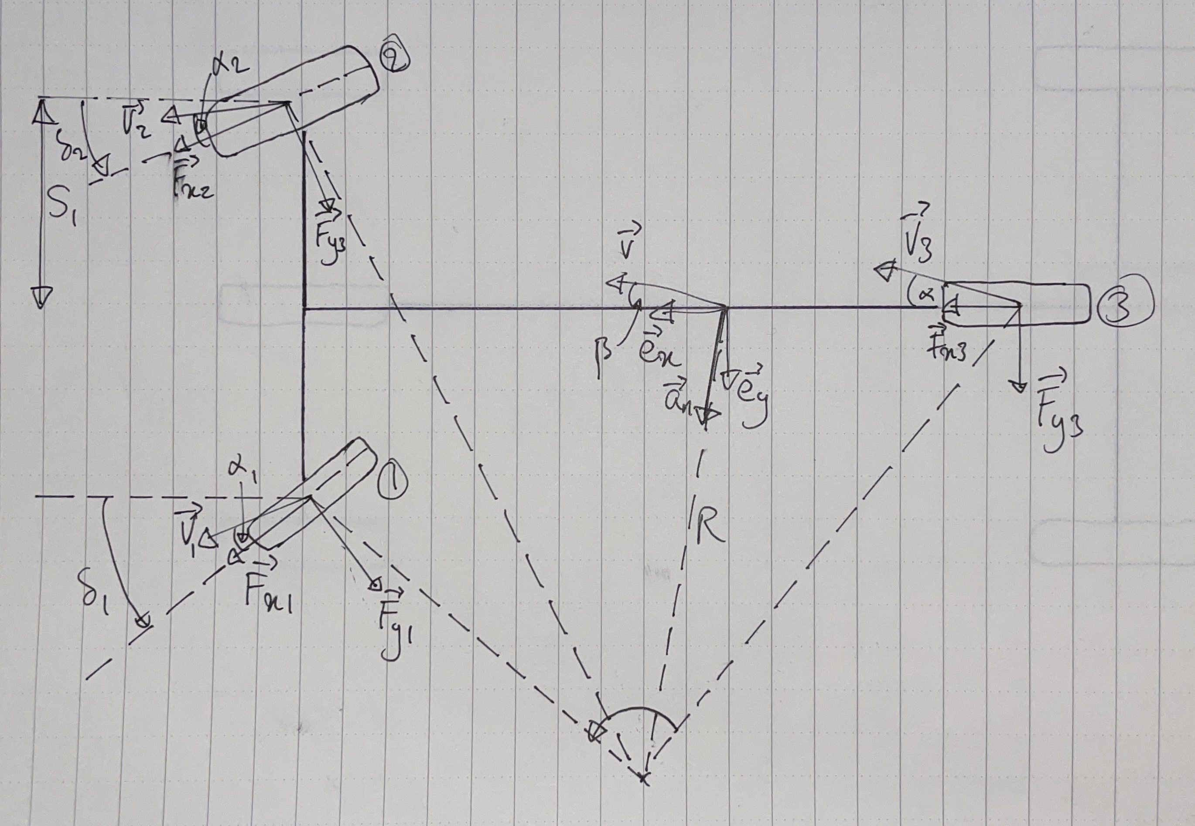
Tire Model
Pacejka Magic Formula [1]
Dynamics calculations, load transfer, lateral and longitudinal side slip, magic formula calculations
Inputs: steering angle (rad), velocity (m/s), side slip angle (rad), corner radius (m)
Outputs: Power loss (W), Wheel forces (N)
Vehicle reference frame

Slide 9
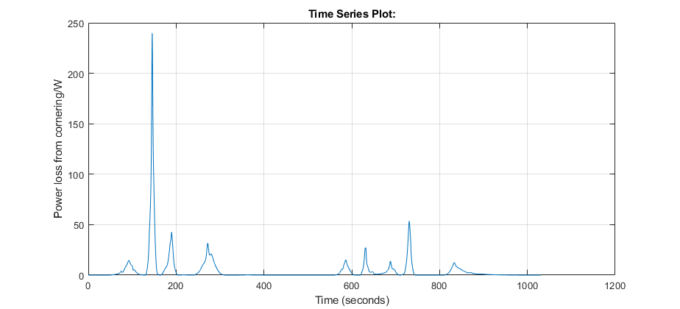
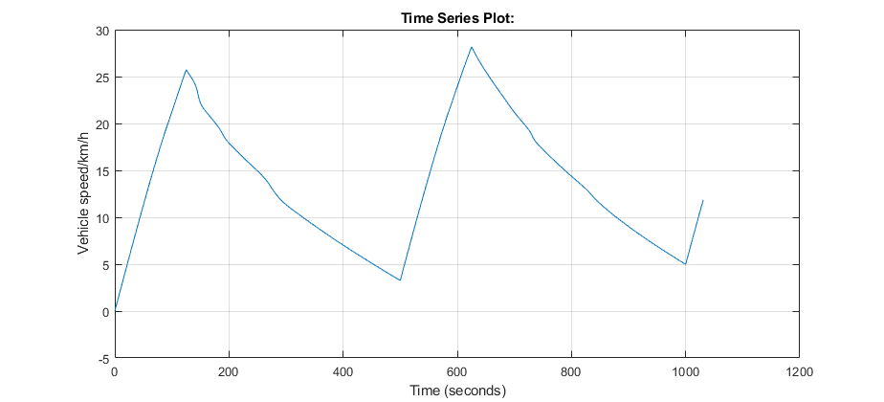
Results
Tire power loss:
Vehicle velocity:

Slide 10

Conclusion and future work
Implement graphical user interface
Implement APIs to pull data from CFD and CAD
[1] Vehicle System Dynamics, Magic Formula Tyre Model, Hans B Pacejka and Egbert Bakker, International Journal of Vehicle Mechanics and Mobility, Volume 21, 1992, Issue sup001
‘I, Hasha Dar, confirm that the work presented in this presentation is my own. Where information has been derived from other sources, I confirm that this has been indicated in the presentation.’

Slide 11
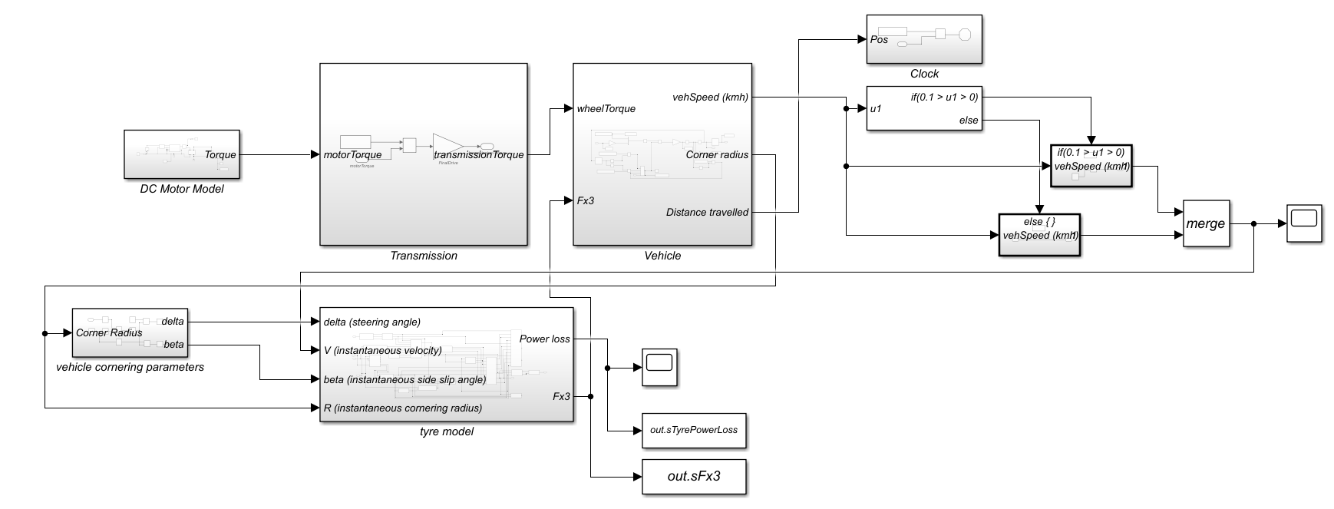

Slide 12
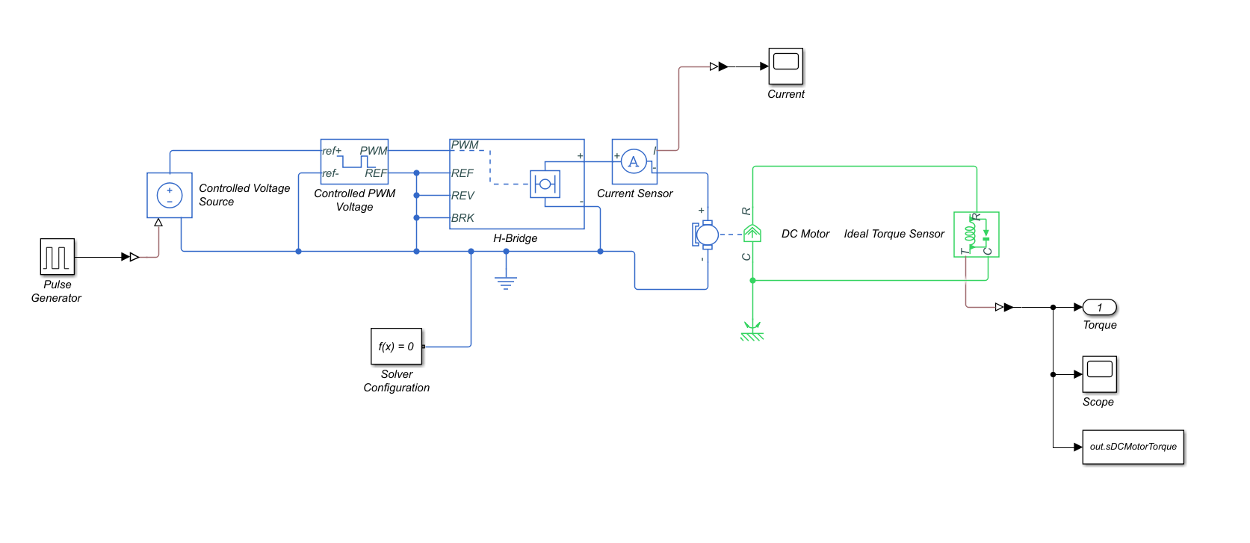

Slide 13
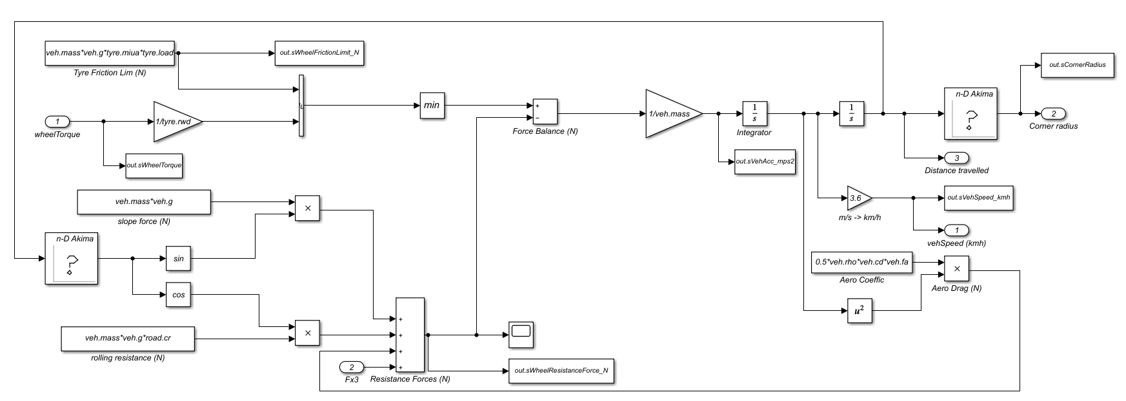

Slide 14
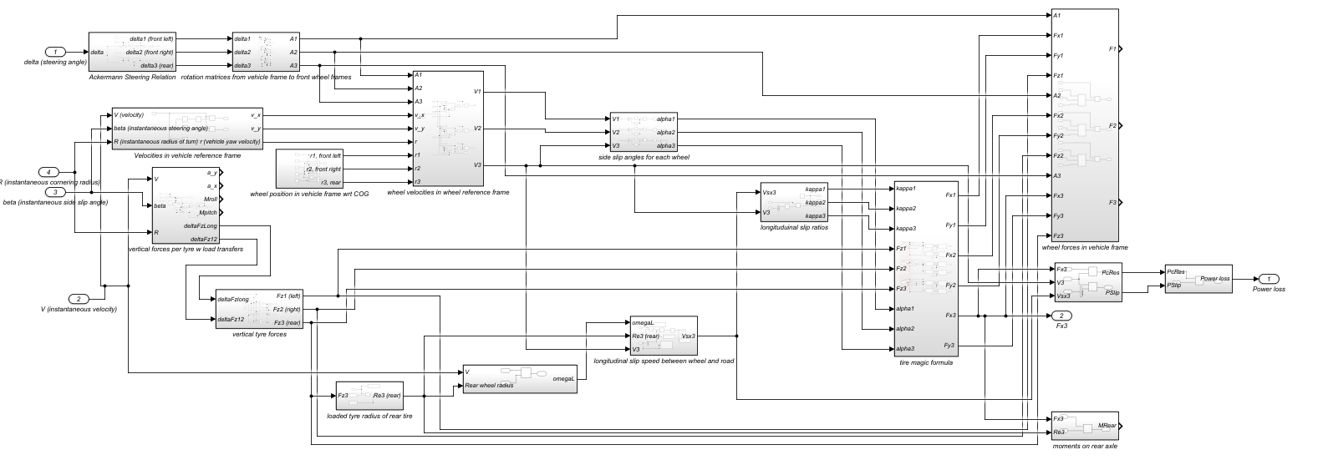

Slide 15
